Slide 1
CRC- Aided Decoding of Polar Codes
GROUP NO - 6
Arjit Mittal-1710110073
Pranika Kakkar-1710110253
Rishika Chaudhary- 1710110276

Slide 2
OBJECTIVE
To improve the performance of the polar codes using CRC aided decoding schemes like CA-SCL/SCS and analysing it’s advantages in terms of lower time complexity and better gains.

Slide 3
TABLE OF CONTENTS
01
INTRODUCTION
02
PRELIMINARIES
CRC - AIDED DECODING OF
POLAR CODES
03
04
IMPLEMENTATION USING MATLAB

Slide 4
INTRODUCTION

Slide 5
Polar Codes : A polar code is a linear block error correcting code. The code construction is based on a multiple recursive concatenation of a short kernel code which transforms the physical channel into virtual outer channels. When the number of recursions becomes large, the virtual channels tend to either have high reliability or low reliability (in other words, they polarize), and the data bits are allocated to the most reliable channels.
CRC : A cyclic redundancy check (CRC) is an error-detecting code commonly used in digital networks and storage devices to detect accidental changes to raw data. Blocks of data entering these systems get a short check value attached, based on the remainder of a polynomial division of their contents. On retrieval, the calculation is repeated and, in the event the check values do not match, corrective action can be taken against data corruption. CRCs can be used for error correction
Channel Polarisation : Combining multiple instances of a channel to get either ideally noiseless channels or very noisy channels, obtained from a single noisy channel through clever techniques, is channel polarisation.

Slide 6
PRELIMINARIES

Slide 7
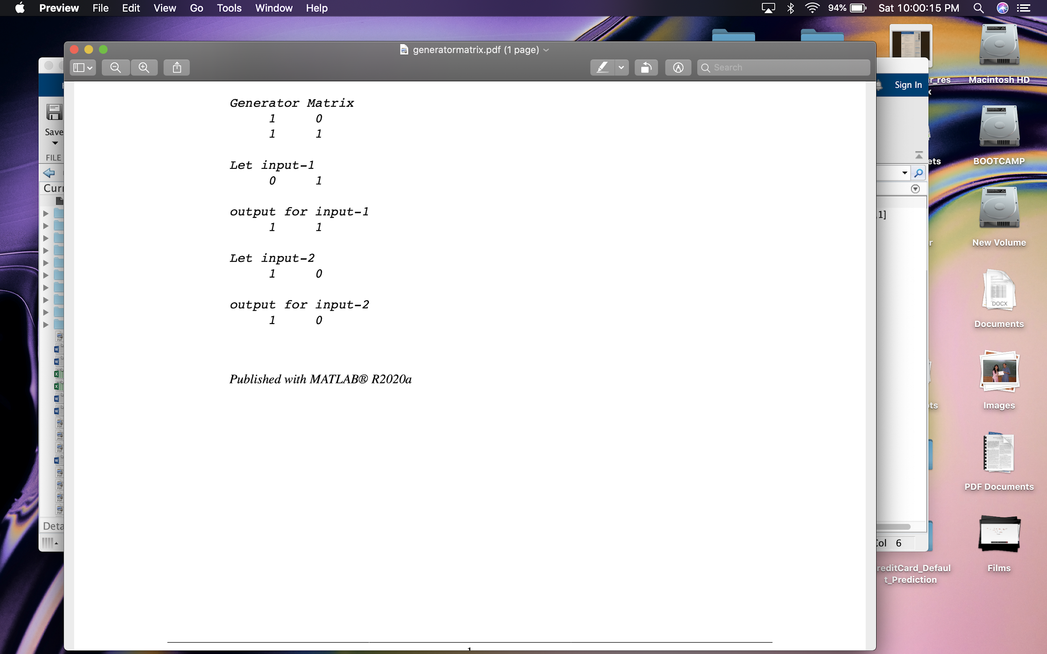
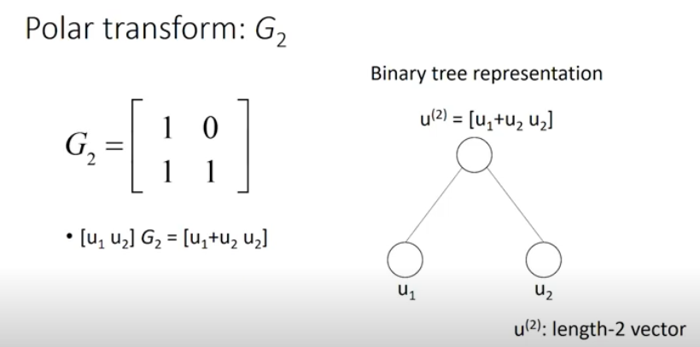
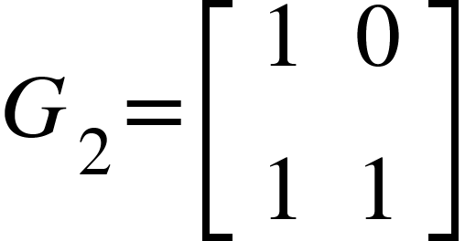
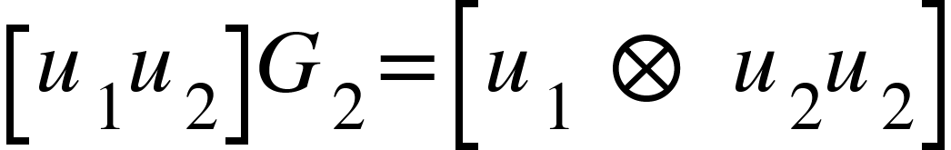
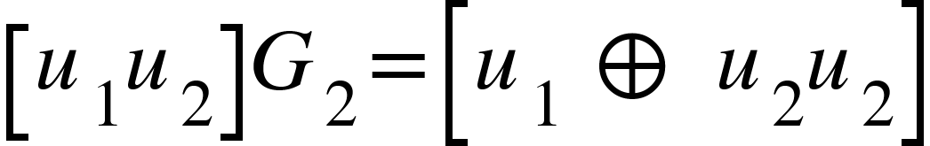
Example of a Polar Transform with the help of a Generator Matrix :
u1,u2 are the two inputs which
are present at the leaf nodes and
we get our output, which is a 2
length vector at the root node.
Figure : Matlab Implementation of Polar Transform (2 bits to 2 bits)

Slide 8
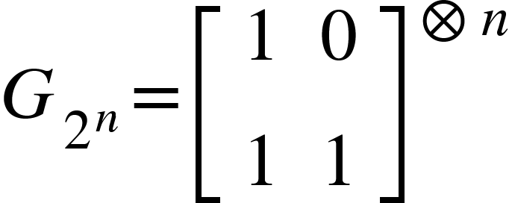

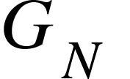
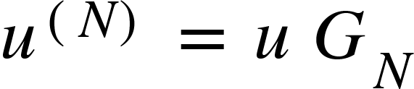


Polar Transform
N =
= N x N matrix, Kronecker product of 2 x 2 kernel
Binary tree representation
1. Depth n
2. : evaluated on tree with u at the bottom and at top
A (N,K) Polar code -Message m of length K bits
Polar Encoding - a vector u of length N bits as follows
1. Find N-K least reliable channels from the reliability sequence
2. Set for those N-K channels to zero (frozen bits )
3. m : Remaining k bits of u (message bits)

Slide 9

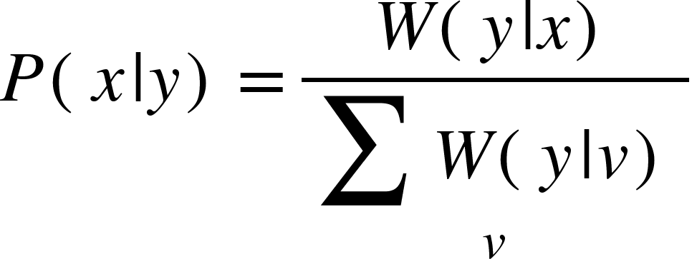
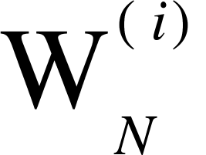

Notations and the A Posteriori Probability
Assuming the communication over a B-DMC ,where X and Y denote input and output alphabet respectively. The channel transition probabilities are defined as
x is a uniform distribution on X , thus the channel a posteriori probabilities can be written as:-
After channel combining and splitting operation on N = , we get N successive uses of synthesised binary input channels with i = 1,2,..N . The information bits can be assigned to the channels with indices in the information set A, which are the more reliable subchannels. The complementary set denotes the frozen bit set and the frozen bits u which are the least reliable bits are therefore set to all zeroes, for the symmetric channels.

Slide 10
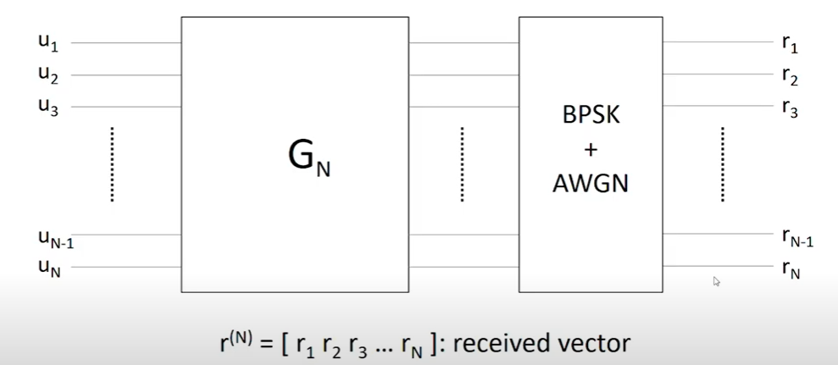


DECODING SCHEMES
are the inputs to the polarization kernel . Some of these inputs are frozen bits and the others are message bits. After the polarization is done, we have Binary Phase Shift Keying is done and noise is added .
After which we get our received vector
. The goal is to get back our input for the received vector.

Slide 11
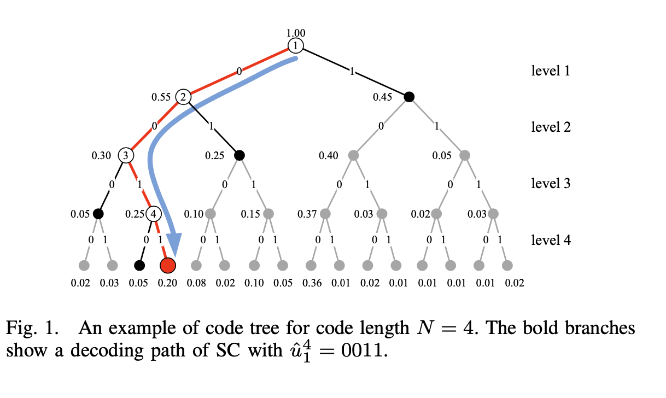
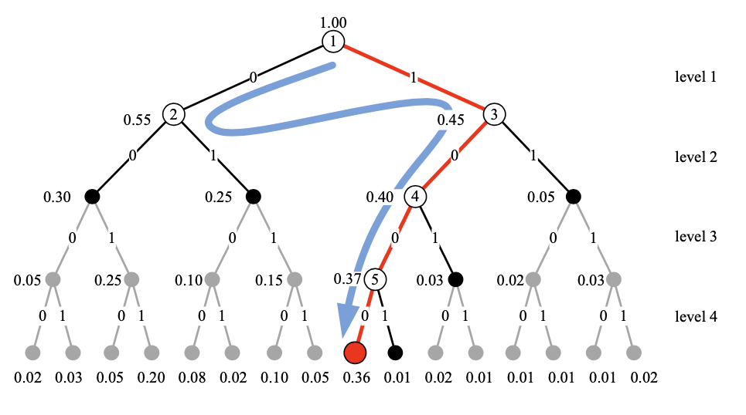
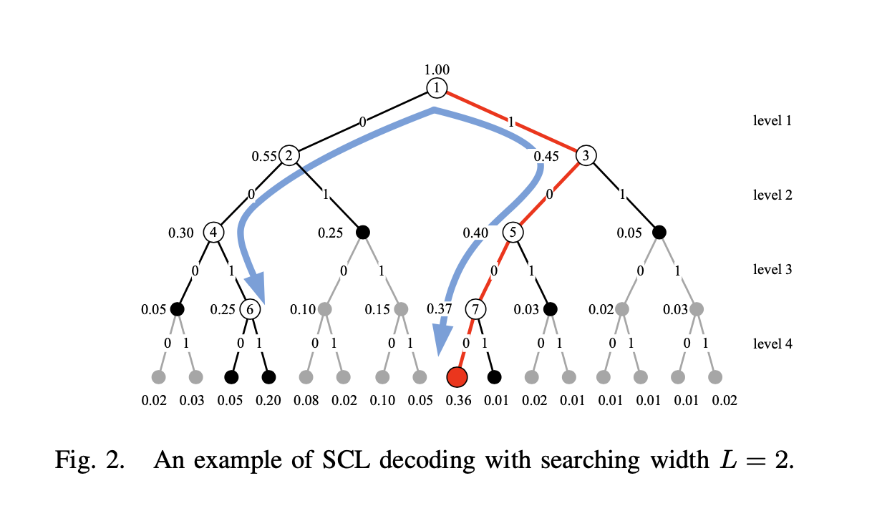



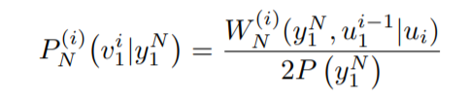
SUCCESSIVE CANCELLATION DECODING
This successive decoding can be represented as a path searching process on a code tree. For a polar code with code length N, the corresponding code tree T is a full binary tree.
More specifically, T can be represented as a 2-tuple (V, E) where V and E denote the set of nodes and the set of edges respectively.
The depth of a node v ∈ V is the length of the path from the root to the node. The set of all nodes at a given depth d is denoted by Vd, d = 0, 1, · · · , N. The root node has a depth of zero.
A i-length decoding path {e1, e2, ..., ei} consists of i edges, with ei ∈ Ei , i ∈ {1, 2, · · · , N}. A vector is used to depict the above decoding path, where vi is corresponding to the binary label of edge ei.
The reliability of a decoding path can be measured using a posteriori probability
Time and space complexity are as follows :
and
Figure : An example of SC Decoding with code length N=4 and the path as 0011. But ,the path 1000 has the largest probability of all the N-length paths, but it failed in the competition at the first level

Slide 12


SUCCESSIVE CANCELLATION LIST DECODING
The successive cancellation list (SCL) decoder searches level-by-level on the code tree.
However, unlike SC where only one path is reserved after processing at each level, SCL allows at most L candidate paths to be further explored at the next level.
SCL can be regarded as a breadth-first searching on the code tree T with a searching width L.
During the SCL decoding, a bunch of candidate paths will be obtained and stored in a list. Since for every single candidate path, the metric calculations and bit determinations are still performed bit- by-bit successively.
Space Complexity of SCL :
Computational Complexity of SCL :
Figure : An example of SCL Decoding with L =2.It finds the most probable path as 1000.But the times of metric computations is increased.
Notes:
Enhanced version of SC

Slide 13

SUCCESSIVE CANCELLATION STACK DECODING
The SCS decoder uses a ordered stack S to store the candidate paths and tries to find the optimal estimation by searching along the best candidate in the stack.
Whenever the top path in the stack which has the largest path metric reaches length N, the decoding process stops and outputs this path.
Unlike the candidate paths in the list of SCL which always have the same length, the candidates in the stack of SCS have difference lengths.
Space Complexity of SCL :
Time Complexity of SCL :
Figure : An example of SCS Decoding compared with SCL, SCS can also find the most probable path 1000 with fewer metric computations
Notes:
, if the metric of a N-length decoding path is larger than that of another path with length l < N, it must also be larger than the metric of any of the N-length descendant path of the latter. So rather than waiting after processing at each level, we can keep on searching along the single candidate path until its metric is no longer the largest. Once a N-length path is found with the largest metric among all the candidate path, its binary label vector is simply output as the final estimation, the unnecessary computations for extending other paths are then saved. D be the maximum capacity of the stack.

Slide 14
3 . CRC - AIDED DECODING OF POLAR CODES

Slide 15
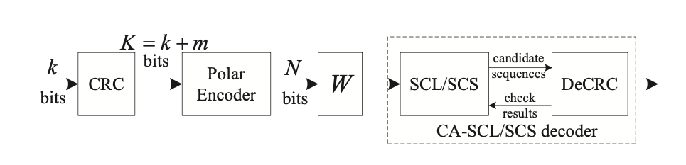
CRC codes are the most widely used for error detecting in practical communications systems. K-bit input block of the error-correcting encoder consists of k information bits and an m-bit CRC sequence, i.e. K = k+m. By viewing the CRC bits as part of source bits for the error correcting code, the code rate is still defined as R = K/N. In this paper, we propose a combination of SCL (SCS) decoder and CRC detector to further improve the performance of polar codes. As shown in Fig. 1, at the receiver, the SCL (SCS) decoder outputs the candidate sequences into CRC detector and the latter feeds the check results back to help the codeword determination. We refer to such a decoding scheme as CRC aided SCL/SCS (CA-SCL/SCS).
Originally Transmitted bits
Figure 1 : Polar coded and CRC - aided decoding schemes

Slide 16
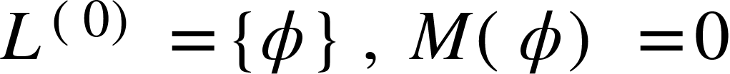
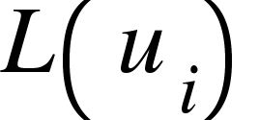

CRC-AIDED SUCCESSIVE CANCELLATION LIST DECODING
The CRC-aided SCL decoding algorithm with the size of list L, denoted by CA-SCL (L), can be described as follows:
Initialization: One null path is included in the initial list and its metric is set to zero, i.e.
.
At the i-th level of the code tree, double the number of candidate paths in the list by concatenating new bits, taking values of 0 and 1 and update the respective path metric.
where is the decision associated to each node.

Slide 17
If the number of paths in the list exceeds L in the last step then keep the best L paths with largest metrics and discard the rest.
How to choose path:
Repeat the last two steps until Level-N is reached.
The path that passes the CRC detection is estimated as the Optimum path by the decoder.
If none of the path passes the CRC-detection after traversing the whole L, then the algorithm declares an output failure.

Slide 18
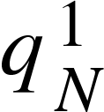


B. CRC-AIDED SUCCESSIVE CANCELLATION STACK DECODING
Let D and T denote the maximal and instantaneous depth of the stack in SCS decoder respectively. An additional parameter(from SCS decoding) Q is introduced to limit the extending paths that have same length. A counting vector =( ) is used to record the number of the popping paths with speciﬁc length, i.e. means the number of popping paths with length-i during the decoding process.
SCS decoder can successively output at most Q length-N candidate paths. Note that, in CRC-aided decoding scheme, SCS will not stop until CRC is passed or the limit Q is reached. The CA-SCS algorithm with the path counting limit Q and maximal stack depth D, denoted by CA-SCS (Q, D), is summarized as follows:

Slide 19

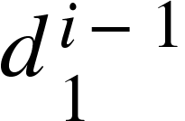

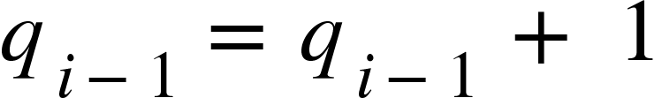



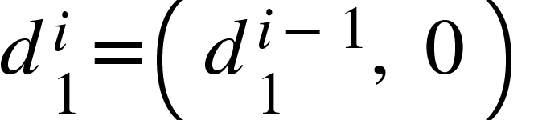
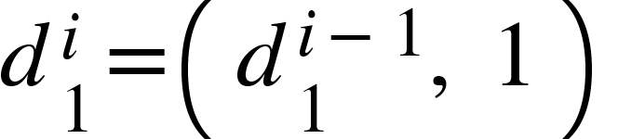



Working Of the CA-SCS Algorithm :
Initialization : Push the null path into stack and set the corresponding metric M (φ)=0. Initialize the counting vector with all-zeros and set
Popping : Path is popped from the stack, and rest variables are updated with and if the path is not null, set .
Competition : If reaches the limit Q then, delete all the paths with length equal to or less than from the stack and update T respectively.
Expansion : For a frozen bit , simply extend the path to otherwise, if di is an information bit, extend current path to and (Here we extend for both possible decision). And calculate the path metric for the same.
Pruning : For information bit , if , delete the path from the bottom of the stack and set . Then push the two extended paths into the stack and set . Otherwise, for frozen bit , push the path , into the stack and set .

Slide 20
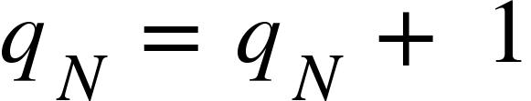
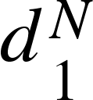
Sorting : the path in descending order from top to bottom in the stack.
CRC-aided decision : Now comes the most important decision (CRC)
If the top path in the stack reaches the leaf node(that has no Left or Right child) then pop that path and set and
A CRC check is performed for the path :
If passed, then this is the estimated path. Algorithm stops and is taken as the decision sequence.
If not, then this top path is popped out and CRC is checked on the next path .
If the CRC checking is not passed on any path or the stack is empty then the algorithm stops and declares failure. Otherwise goes back to popping stage.

Slide 21
SUMMARIZING THE MAIN DIFFERENCES
CA-SCL
The path extension is parallel.
It’s time complexity is
and is fixed.
The space complexity for this algorithm is
CA-SCS
The path extension is serial
The time complexity is variable and no more than that of the CA-SCL.
The space complexity is which is usually greater than CA-SCL.

Slide 22
4. IMPLEMENTATION USING MATLAB

Slide 23
IMPLEMENTATION
01
02
03
04
Applying Polar transform to a given N length sequence. Then noise is added by applying Binary Phase Shift Keying.
SCL and SCS decoder is implemented by finding the Path Metrics which would be used in the respective algorithms.
Now the output of the SCL and SCS decoder is passed through a CRC detection to obtain the optimum path which results in the original message with the least error.
BLER performance comparisons (complexity and performance) is done on CA-SCL and CA-SCS using the BLER Graph

Slide 24
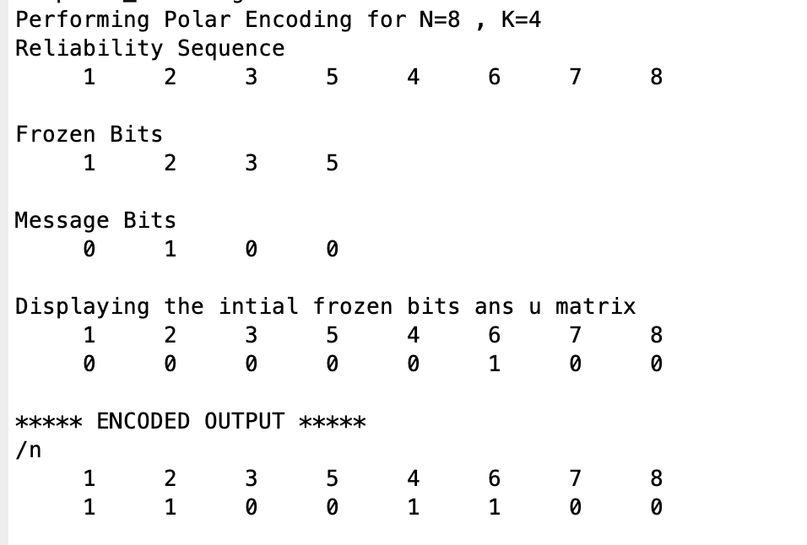
POLAR ENCODING
The algorithm for the is as follows:
Extracting the reliability sequence i.e Q1=Q(Q<=N), where Q is 5G standard 1024 Reliability sequence.
Define the Frozen position-Q1(1:N-K)
Defining the message positions Q1(N-K+1:end)
Generating a random message bit pattern.
Defining u as u=zeros(1,N) and the bits that are not frozen will be assigned the message.
Next, the computation of bits on each depth of the binary tree takes place ranging from (N-1 ,-1, 0) where 1 bit is combined at a time and stored in two parts a and b.
Figure-MATLAB published file for polar encoding for N=8,K=4

Slide 25
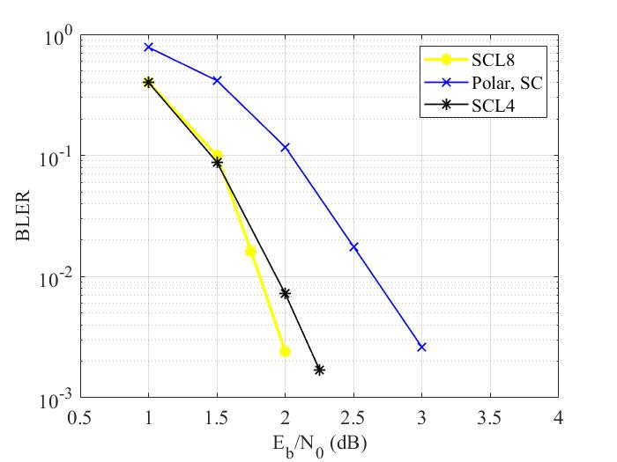

INTERPRETING THE GRAPH
BLER vs Eb/No for different schemes.
All the schemes here have the code length N=1024 and code rate=½ and are running over BI-AWGN channel.
It can be observed that the performance of SC L 4 and SCL 8 is much better than that of SC.
At BLER value of almost , there is a difference of 0.7 dB between SCL4 and SC.
Figure : An example of SCS Decoding compared with SCL, SCS can also find the most probable path 1000 with fewer metric computations

Slide 26
CONCLUSIONS FROM THE GRAPH
Polar codes are the first capacity-achieve channel coding in history. The successive cancellation decoder is the first decoding algorithm for polar codes which can achieve binary memoryless symmetric channels’ capacity. However, SC does not perform well. The SC decoder is known to have the least complexity but its corresponding performance is poor. We find that CRC-aided SCL algorithm improves the effect of polar codes. SC List algorithm is proposed and is one of the best algorithms in terms of balance between bits error rate and computation complexity. CRC-aided decoding schemes are proposed to improve the performance of polar codes. They have increased complexity but their performance is better as compared to that of SC decoder which can provide a significant gain of around 0.7 dB.
It is also observed that the size L in SCL decoding affects both the speed and the performance. Increasing L, results in more computation but improves the BLER performance. So, there is a trade-off between speed and performance, and the list L can be chosen accordingly.

Slide 27
APPLICATIONS
It is said that by properly designing, significant reduction of decoding complexity can be achieved with almost the same performance as that of single CRC aided SCL decoding. Moreover, we apply this construction to hybrid automatic repeat request (HARQ) system to aid the retransmission and show that system throughput can be improved.

Slide 28
THANK YOU

